Slide 1


Final Management Committee Meeting
7 September 2026, Lisbon, Portugal

Slide 2
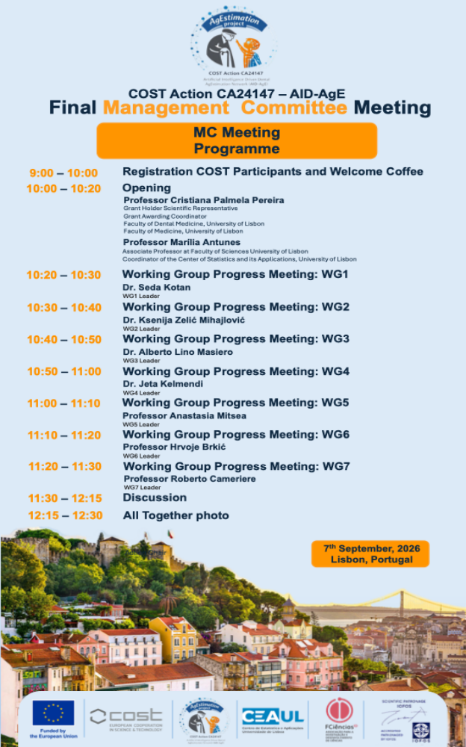
The Final Management Committee Meeting of COST Action CA24147 – AID-AgE brought members together in Lisbon for two days of collaboration and strategic discussion. The meeting provided an opportunity to review the progress of this COST Action, share updates across the Working Groups, discuss scientific outputs and coordinate the next steps for the network.

Slide 3
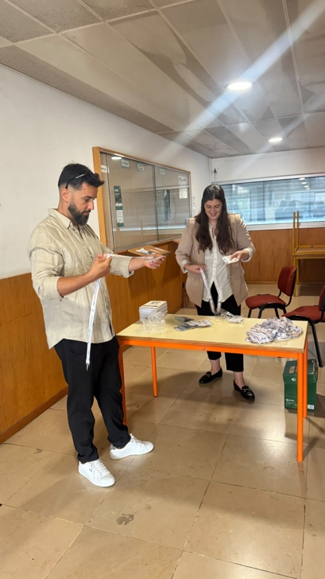
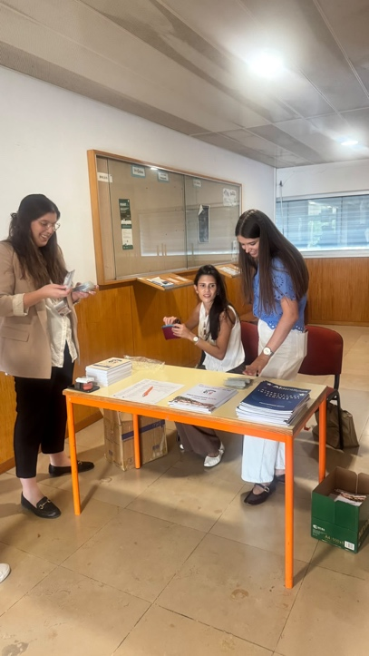
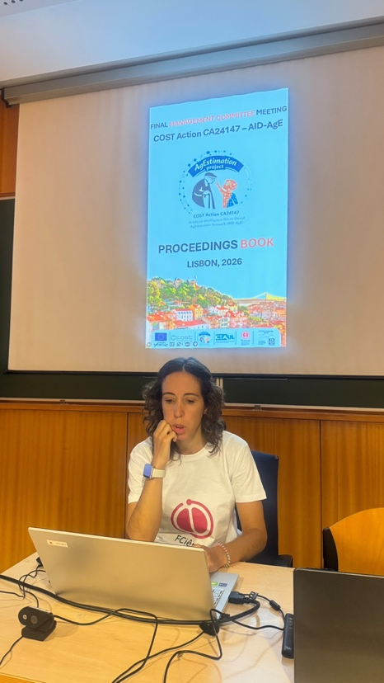

Slide 4
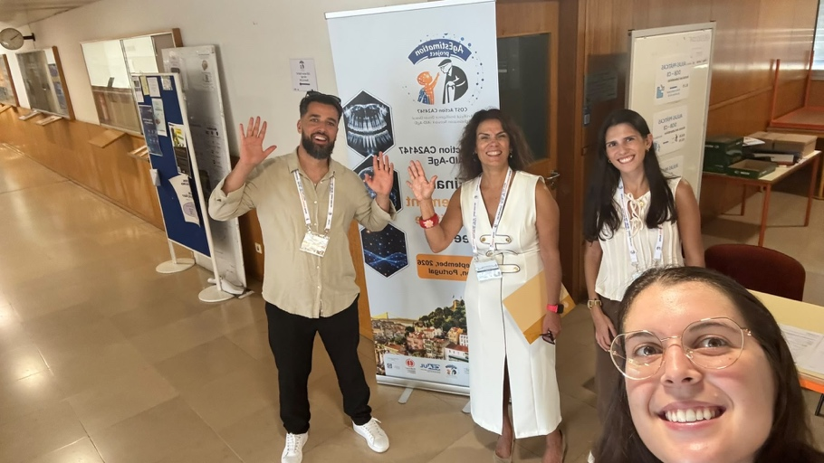

Slide 5
