Slide 1
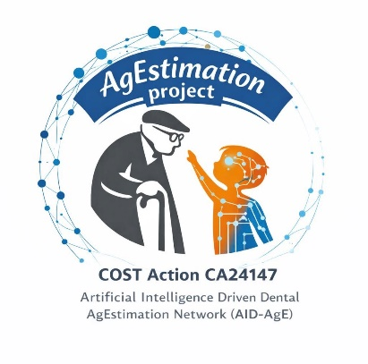

COST Action CA24147 – AID-AgE Workshop
8 September 2026, Lisbon, Portugal

Slide 2
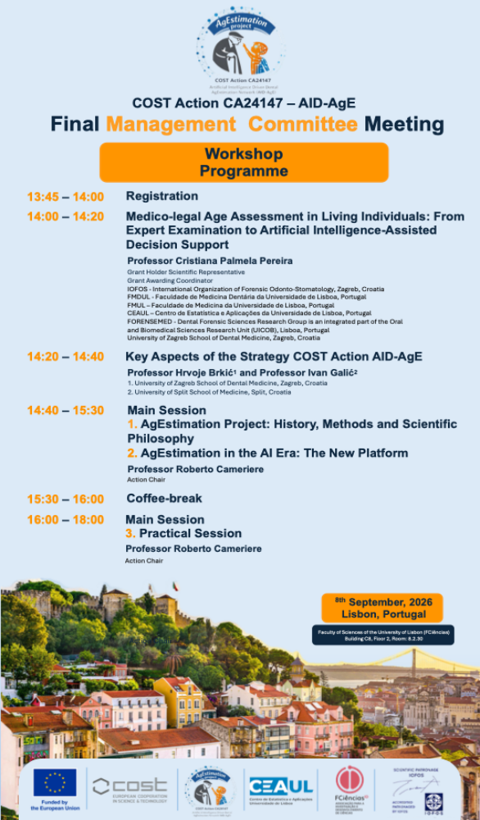
As part of COST Action CA24147 – AID-AgE, a workshop open to external participants was held in Lisbon on 8 September 2026. The event brought together researchers and participants for an interactive session focused on knowledge exchange, scientific discussion and collaboration related to AI-driven dental age estimation.

Slide 3
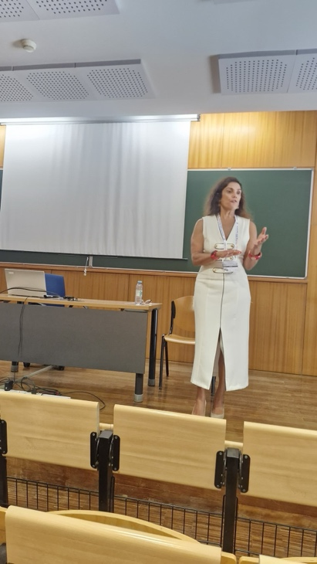
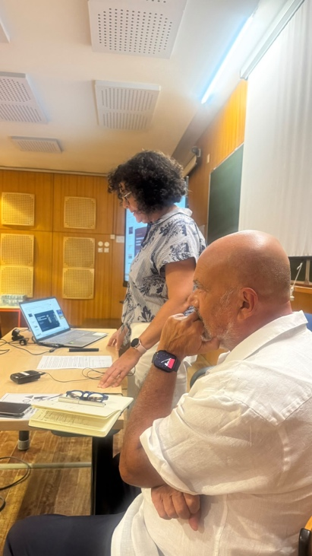

Slide 4
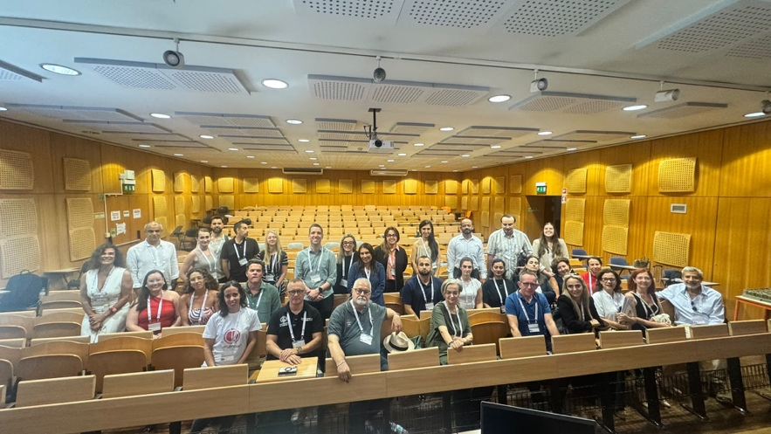

Slide 5
