Slide 1
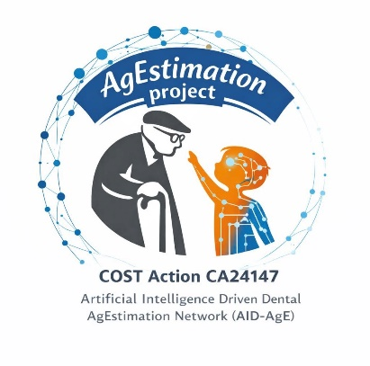

Technical Seminar
7 September 2026, Lisbon, Portugal

Slide 2
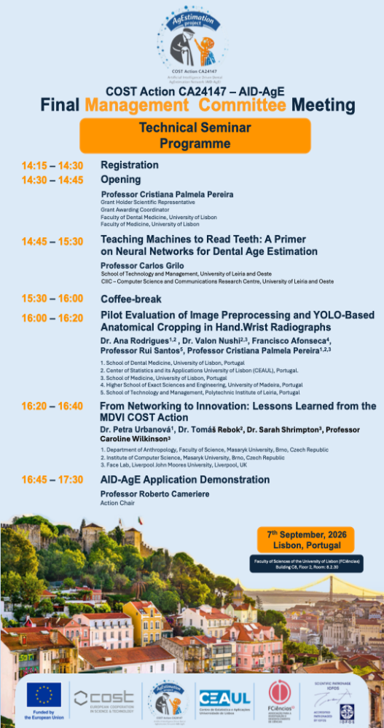
As part of the Final Management Committee Meeting of COST Action CA24147 – AID-AgE, a Technical Seminar was held in Lisbon, opening the programme to external participants and creating an opportunity for wider scientific exchange.
The seminar explored the intersection of artificial intelligence, dental age estimation and image analysis, beginning with various presentations from the professors and experts in the field of Artificial Intelligent. An engaging afternoon bringing together expertise, innovative approaches and discussion around the growing role of AI in age-estimation research.

Slide 3
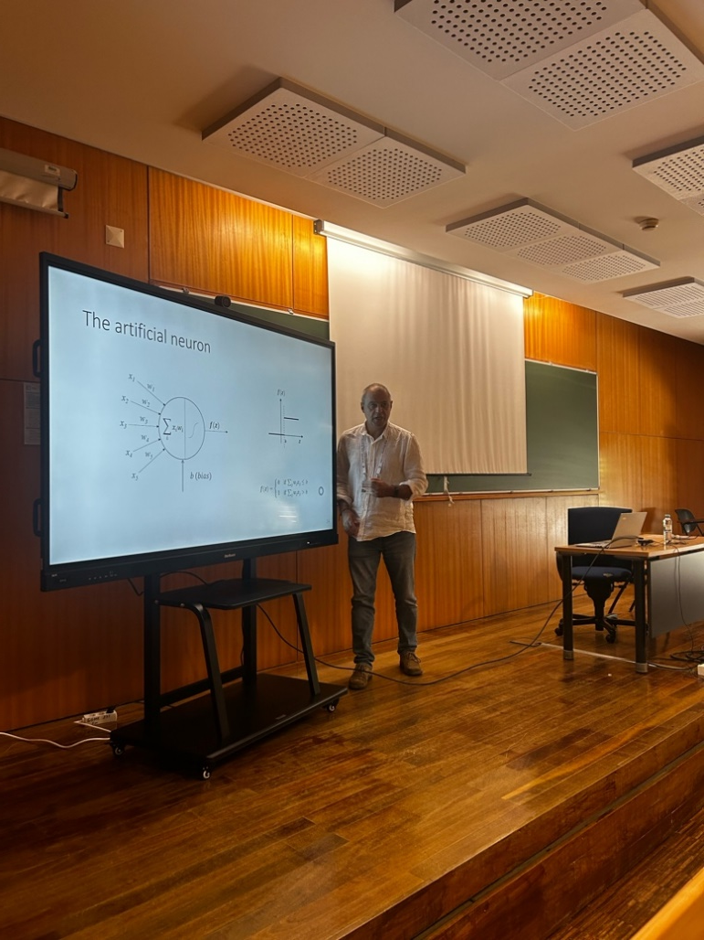
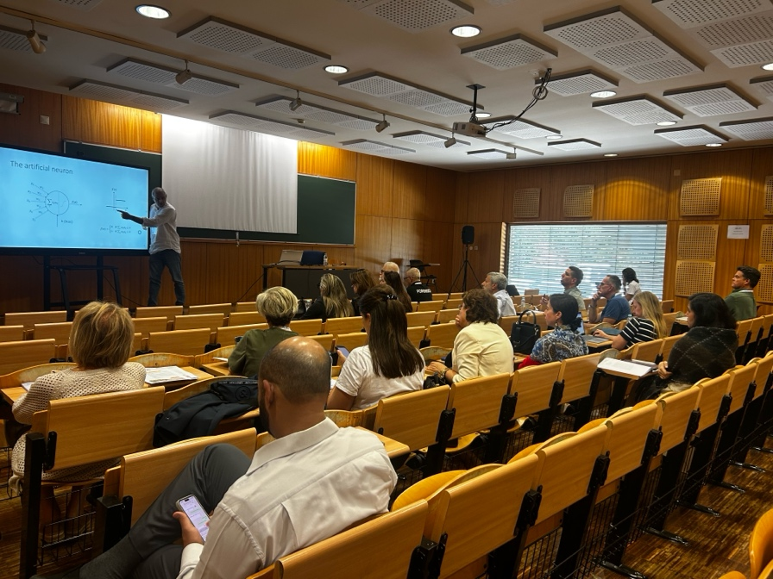

Slide 4
